Slide 1
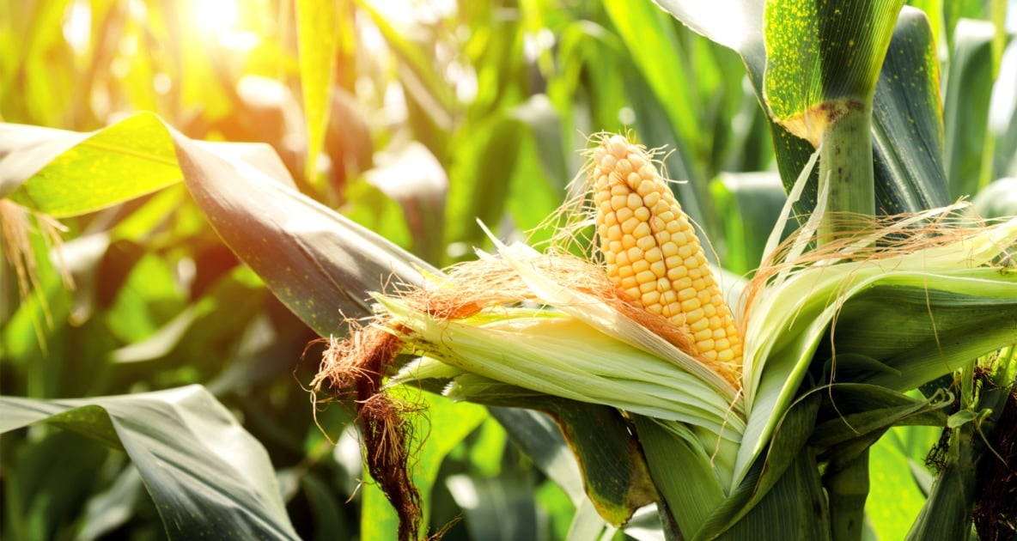
Corn Leaf Disease Classification
A Convolutional Neural Network Analysis
By Clement Chen

Slide 2
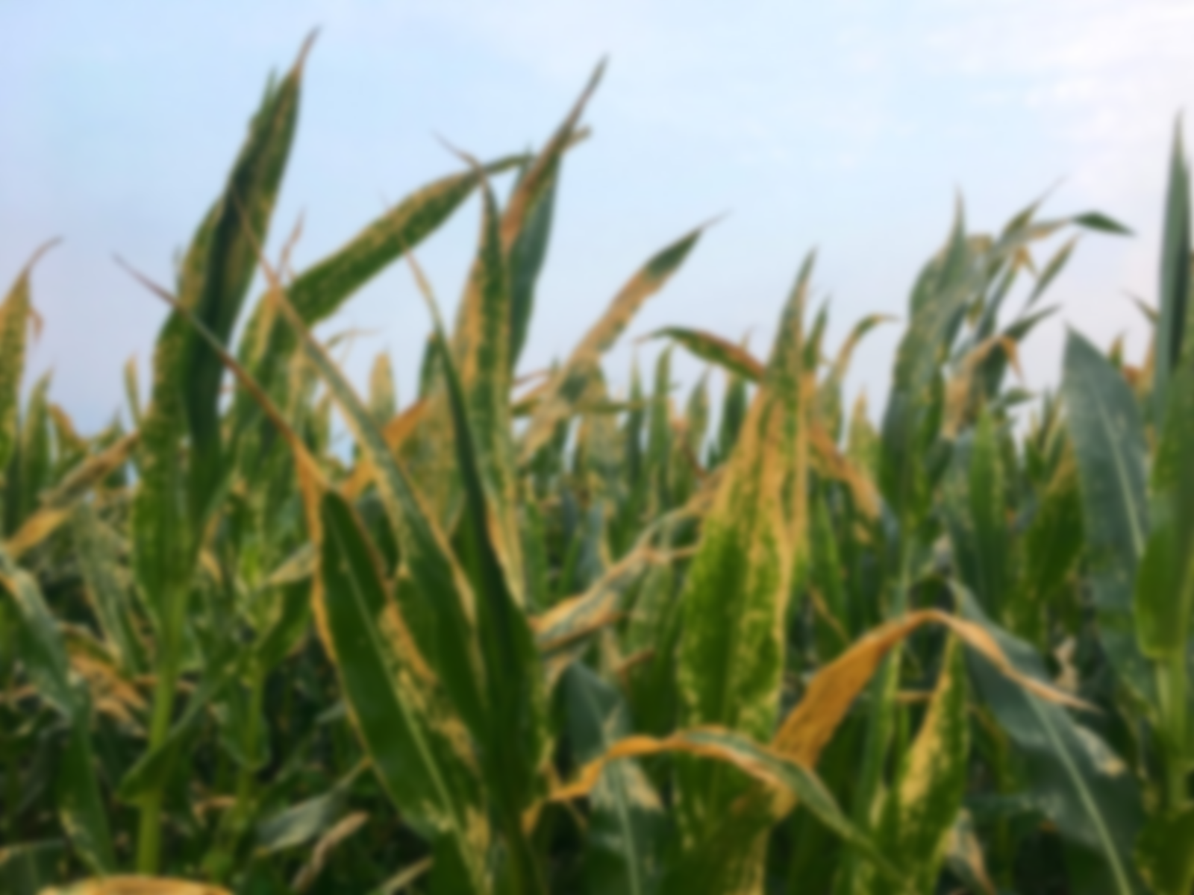
The Problem:
Corn leaf diseases are diverse and prevalent causing millions in losses each year
Current way of identifying corn leaf disease is through slow laboratory testing
Human identification can be prone to errors
Can we develop a machine learning algorithm that can predict corn leaf disease?

Slide 3
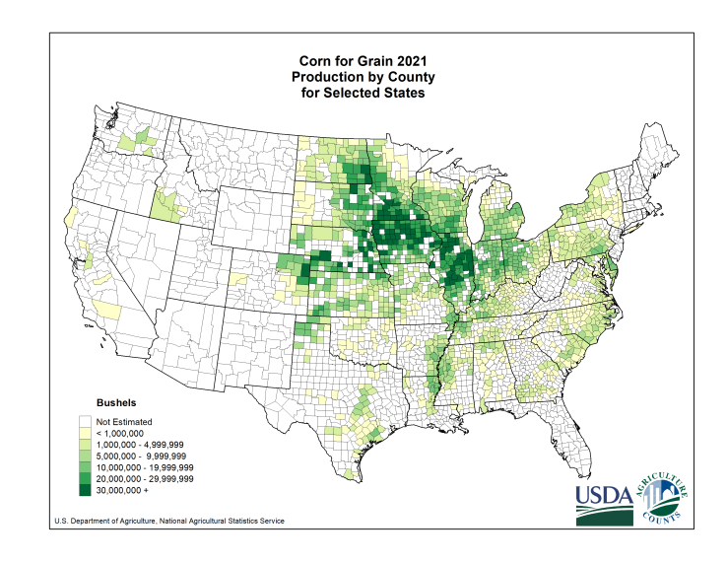




Who Would Find This Analysis Useful?
• Farmers
• Food and Beverage Corporations
• Energy Industry

Slide 4
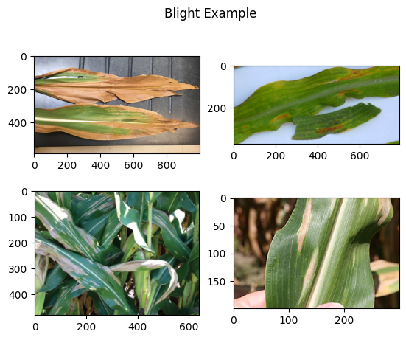
Corn Leaf Dataset
• 4188 RGB JPEG images of various dimensions
• Source: PlantDoc and PlantVillage datasets
• 4 classes: Blight, Common Rust, Gray Leaf Spot, and Healthy with 1146,1306, 574, and 1162 instances respectively
• The images have varying backgrounds, lightning, and can part of a leaf or contain multiple plants. Some images are partially occluded.

Slide 5
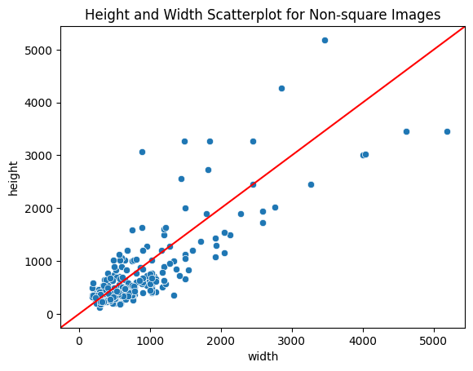
Data Wrangling and EDA
CNNs require input images be the same
92% of our data has dimensions of 256 x 256
The other 8% fall on this scatter plot.
There are several options to resize this data:
• Cropping
• Stretching
• Zero-padding

Slide 6
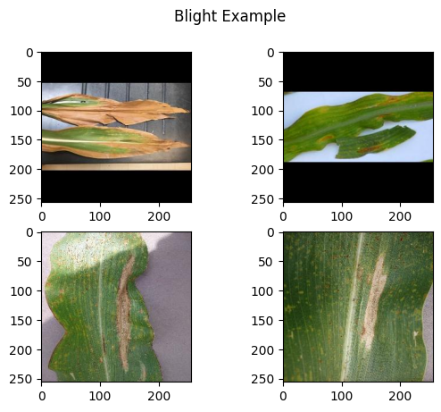
Data Wrangling and EDA
Cropping
• Lost pixels
• Wide variety of image dimensions
Stretching
• Feature distortion due to changed aspect ratio
• Granularity loss
Zero-Padding
• Maintains aspect ratio
• Pad with ‘zero’ pixels

Slide 7
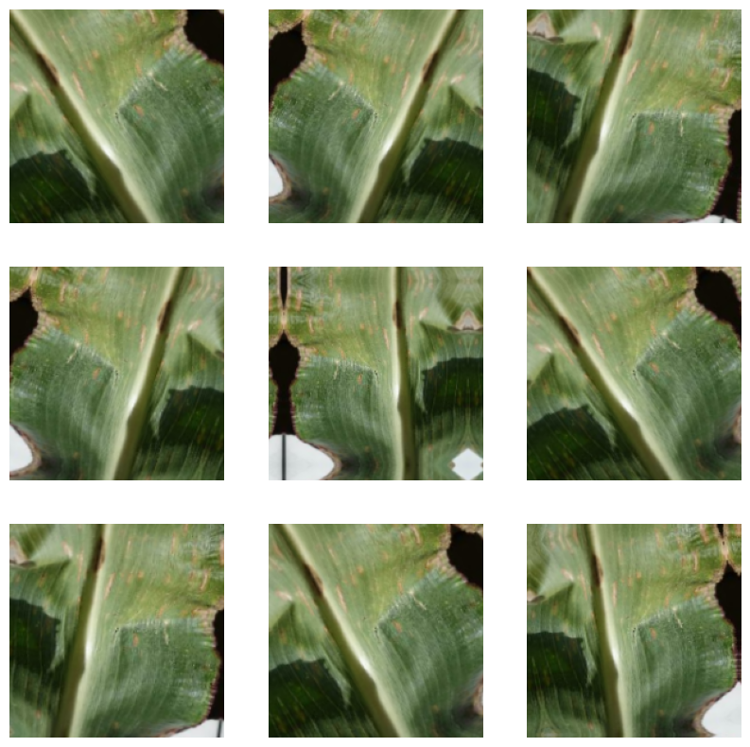
Preprocessing and Modeling
Data Augmentation
• Random horizontal flip
• Image rotation +/- 10%
• Zoom in or out +/- 20%
Data Augmentation provides a way of generating more data for the model to train on to reduce overfitting. One image can generate many other slightly different images of the same class.

Slide 8
Preprocessing and Modeling
Base CNN
Conv2D(f=32,actv=relu)
Model 1
Original Data
Max Pooling(size=2)
Conv2D(f=64,actv=relu)
Data Augmentation
Max Pooling(size=2)
Flatten
Conv2D(f=128,actv=relu)
Output
Class
Inputs
Dense(units=4,actv=softmax)
Max Pooling(size=2)
Pixel Rescaling
Conv2D(f=256,actv=relu)
Model 2
Zero-Pad Data
Max Pooling(size=2)
Conv2D(f=256,actv=relu)
Input Data
Preprocessing
Convolutional Layers
Dense Layers
Output

Slide 9
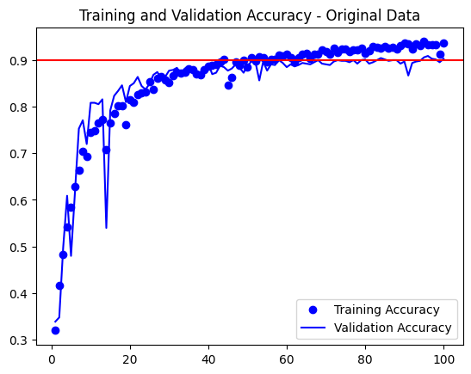
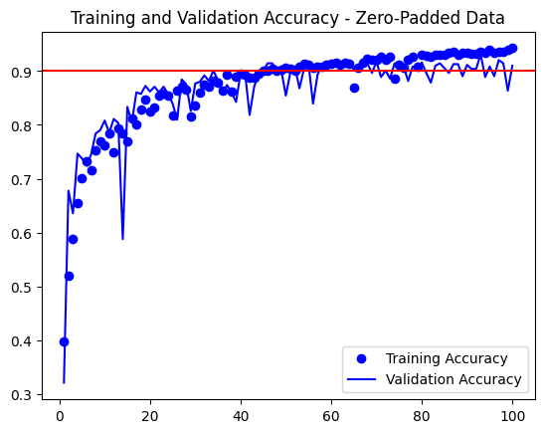
Preprocessing and Modeling
Original data reaches a validation accuracy of ~ 90% before starting to overfit around epoch 65.
Zero-Padded data reaches a validation accuracy of ~93% before starting to overfit around epoch 80.

Slide 10
Transfer Learning CNN
Conv2D(f=64,actv=relu)
Hyperparameter Tuning
Conv2D(f=64,actv=relu)
Max Pooling(size=2)
Units: (128,512),
step=32
Rate: (0.1, 0.5),
step=0.2
Conv2D(f=128,actv=relu)
Flatten
Data Augmentation
Conv2D(f=128,actv=relu)
Zero-Pad Data
Max Pooling(size=2)
Dense(units=256)
Conv2D(f=256,actv=relu)
Dropout(rate=0.1)
Conv2D(f=256,actv=relu)
Pixel Rescaling
Conv2D(f=256,actv=relu)
Inputs
Dense(units=4,
actv=softmax)
Output
Class
Max Pooling(size=2)
Conv2D(f=512,actv=relu)
Conv2D(f=512,actv=relu)
Conv2D(f=512,actv=relu)
Max Pooling(size=2)
Input Data
Preprocessing
Convolutional Layers
Dense Layers
Output
(Frozen VGG16 Weights)

Slide 11
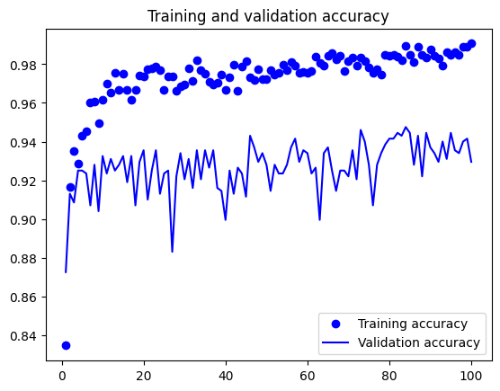
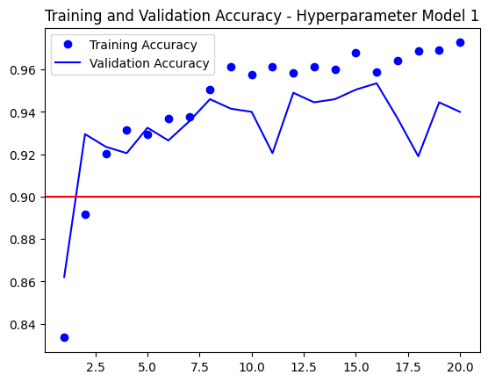
Preprocessing and Modeling
default transfer
Accuracy starts in the low 90s and begins overfitting immediately even with randomly initialized weights in the densely connected layers. (units =256, dropout=0.1)
Our best performing hypermodel reaches an accuracy of ~95% at epoch 16 before beginning to overfit.
(units =128, dropout=0.5)

Slide 12
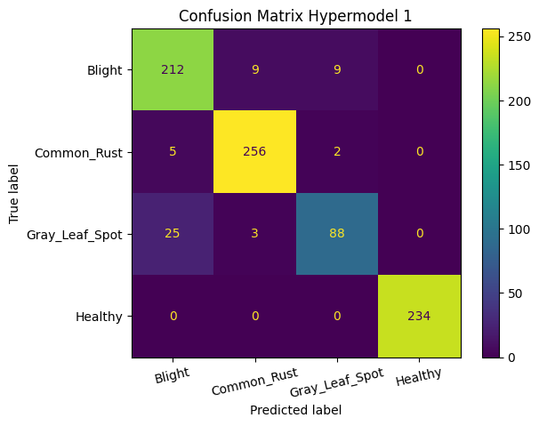
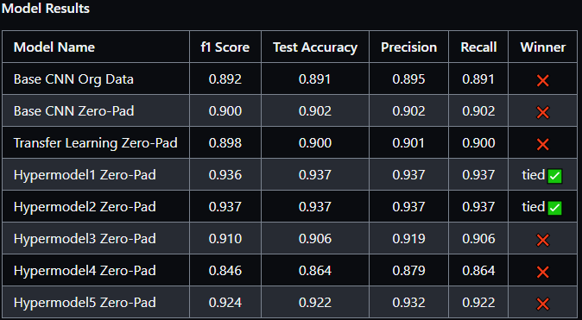

Model Selection on Test Data
Slight improvements with zero-pad data
Hyperparameter tuned transfer models show large improvements
Best 2 hypermodels only have misclassifications between disease classes

Slide 13
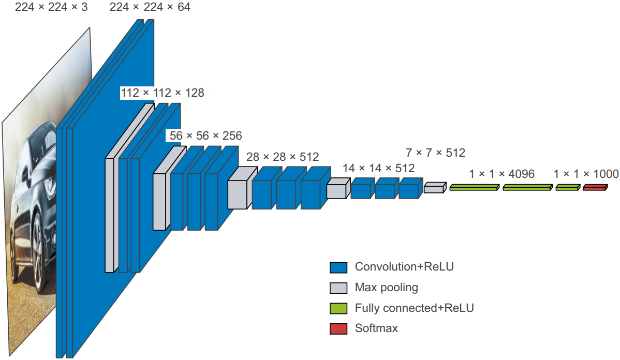
Conclusions
Zero-pad data takes longer to overfit but performs better than original data
Transfer learning reaches high accuracy and overfits very quickly
Hyperparameter tuning is essential for model performance
If our classification task was a binary diseased or healthy leaf, our models would have 100% accuracy (as well as precision recall etc.)

Slide 14
Future Research
Ideas for Future Research
Streamline Corn Leaf Imaging
Acquire Better and More Training Data
• Satellite imagery or drones
• Image segmentation
•More Gray Leaf Spot class instances to balance dataset
• Make sure images are labeled correctly
• Foreground and background
segmentation
• Avoid or work around corn leaf occlusion in images
Change CNN Model Architecture
• Residual connections
• Batch normalization
• Transfer learning from other
Search A Broader Hyperparameter Space
• Number of densely connected layers
• Number of units per layer
• Optimizers such as ‘adam’ or ‘sgd’

Slide 15
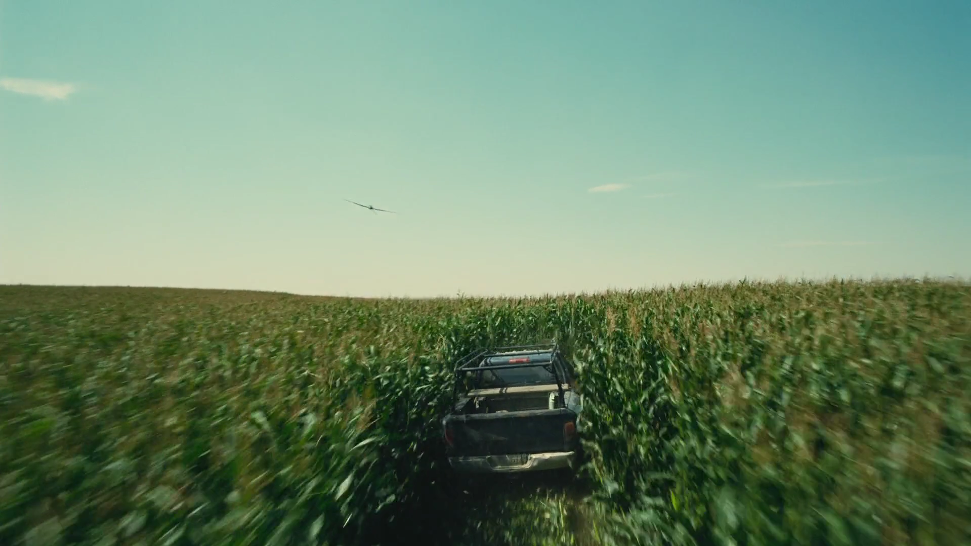
Questions?

